Slide 1
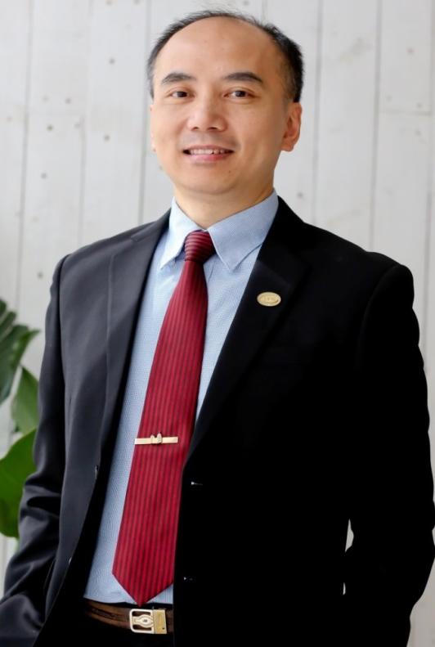


達至成功的抉擇
A Decision to Succeed
YK Tam
高級顧問經理級
Director
四個佣金週期共賺取HK$138,000*
HK$138,000 in 4 Commission weeks
*本簡報中提到的收入等級純屬舉例說明，無意代表美安香港超連鎖™店主的一般收入，也無意表示任何超連鎖™店主皆可賺取同等收入。美安香港超連鎖™店主的成功與否，取決於其在發展事業時的努力、才能與投入程度。The income levels mentioned in the following presentation are for illustration purposes only. They are not intended to represent the income of a typical Market Hong Kong UnFranchise ™Owner, nor are they intended to represent that any given Independent UnFranchise ™ Owner will earn income in that amount. The success of any Market Hong Kong Independent UnFranchise ™ Owner will depend upon the amount of hard work, talent, and dedication which he or she devotes to building his or her Market Hong Kong Business.

Slide 2
畢業於台灣大學，主修醫事技術
台灣合格醫檢師
香港一級醫務化驗師
中國國家授證高級公共營養師
多次UFO挑戰獎及總裁挑戰獎
授證訓練員；香港/台灣產品訓練講員
Graduated from National Taiwan University with a degree in medical technology
A medical technology scientist of Taiwan
Medical laboratory technologist (Part1)
A senior public nutritionist of the PRC
Many times of UFO & President Challenge winner
A Certified Trainer; Hong Kong / Taiwan Field Product Specialist
YK Tam

Slide 3
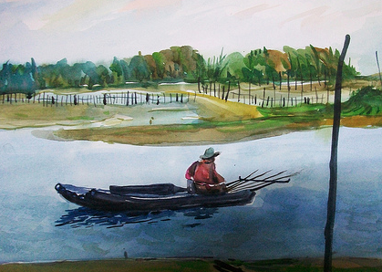
甚麼是成功? What is success?

Slide 4
甚麼是成功? What is success?
$$$$$$$
有權有勢 Powerful
學術偉人 A person with great academic performance
自由自在Free
身體健康Healthy
夢想成真Dreams Come True
$$$$$$$$$$$$$$$$$$$$$$$$$$$$

Slide 5
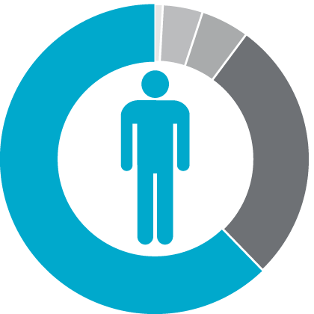
在年滿65歲的每100個人中…
4%財務穩健
4% Financially Fit
For every 100 people who should have reached the age of 65...
1%富有
5%仍在工作
1% Wealthy
5% Still Working
62% Struggling
Financially
62%貧窮／身無分文
28%已逝世
28% Dead

Slide 6

45年計劃
45 YEAR PLAN
2到3年計劃
2 TO 3 YEAR PLAN

Slide 7
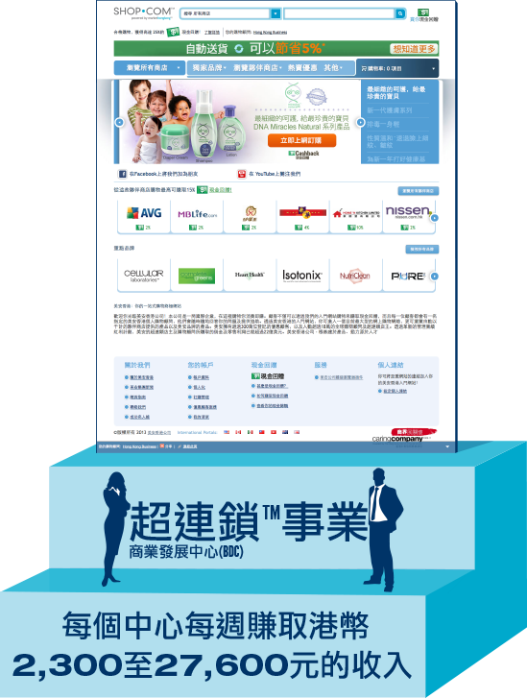
45年計劃
The 45 Year Plan
投資收入
儲蓄收入
股票基金
投資
儲蓄
銀行
打工收入
支出
超連鎖™事業
UnFranchise™ Business
永續收入
2到3年計劃
The 2-3 Year Plan
MPCP(管理業積紅利計劃)

Slide 8
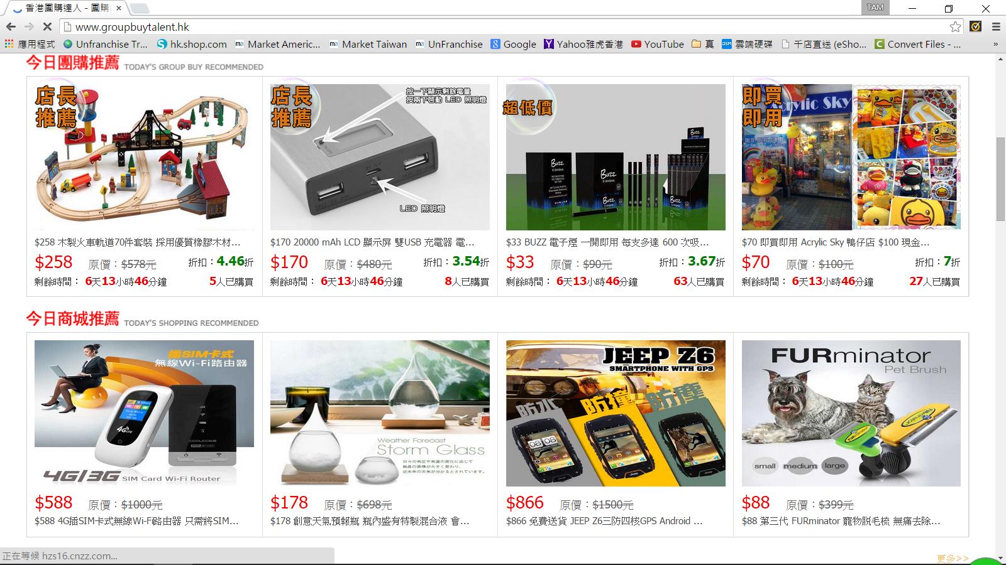

Slide 9


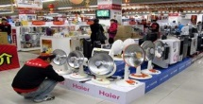
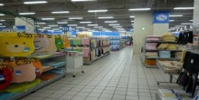
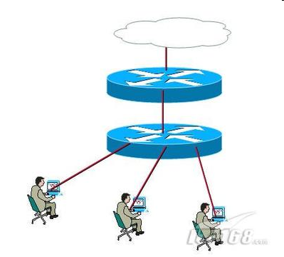

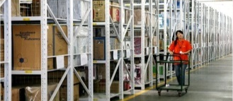
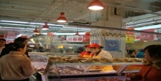
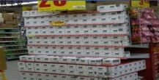

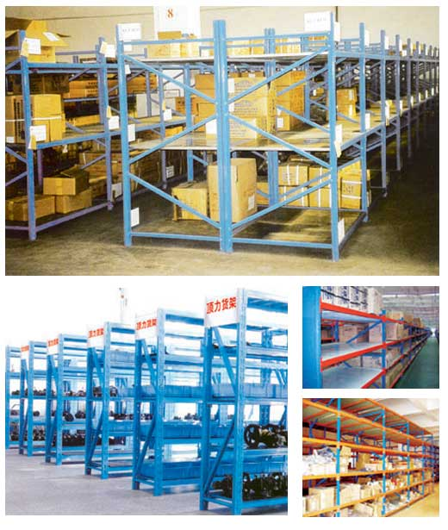
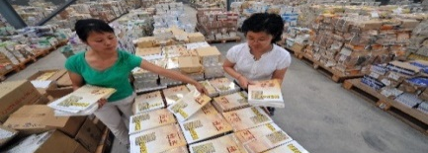
成本: $5
價錢 $10
消費者
倉儲物流
$ $
倉儲物流
$ $
現在 $60
廣告行銷
$ $
現在 $40
實體通路：分店
現在 $100
實體通路：總倉
零售差價40元!!!
$40 difference in retail price!
生產廠商
總倉直接出貨
成本較低
$ $
廣告行銷
$ $
現在 $40
現在 $80
廠商倉庫
網路通路：總倉
提供商品資料
不會產生成本
一對一行銷
現在 $60
直接下訂單
搜尋
購物入口網站
Notes:
從生產者的角度來看美安
美安的概念是生產者直接賣給消費者，在電子商務成熟後，理論上可行，但實務上還有缺憾。
以前東西生產後，還要經過代理、總經銷、大、中、小盤、零售商，而中間這一連串的通路都需要管銷及倉儲，所以成本與價格就一路疊上去。
有了電子商務後，中間會少很多層，但是購物網站還是需要有自己的管銷及倉儲，不過比起前者來說已經低了許多。
產品的行銷費用還是最大的成本，品牌知名度不足的商品，放在有上百萬種商品的購物網站，如果沒有適當的行銷，一樣還是會被淹沒，所以大部分的利潤還是給購物網站，而不是生產者。
所以電子商務雖可以減少通路成本，但還是大財團才能玩，以有機蔬果為例，認真誠實的農民生產的作物，你說他有幾百萬去行銷品牌？還是只能賣給大財團開的連鎖事業？因為消費者只認識它們，而不容易隨便信賴個體戶！
而美安提出的一對一行銷，它一方面保留了電子商務的效率，一方面用人與人信賴的基礎來口耳相傳，例如：您的好朋友跟您說OO農場種的芭樂超好吃，您一定相信，也願意也買來吃看看，這比您看到某財團花了一千萬打電視廣告對您的影響力還要大！
但如果您要買，美安的模式是：不需要找您的朋友買，您只要透過美安的購物入口網站，直接去OO農場的網站下單，金物流都與你無關（保留電子商務效率，但留下客戶忠誠），對OO農場來說，本來批發給中間商幾乎沒利潤，利潤少卻要養家，就只好擴大產量，要擴大產量就只好用大量農藥及肥料…….（惡性循環）
所以，透過美安一對一行銷，當美安的經銷商知道OO農場認真又可信賴，消費者會願意用市價（或者比市價少一點）來跟他買，而因為OO農場直接將產品賣給消費者，原本屬於中間商的利潤就保留下來了， OO農場不用拼產量，作他想作又合於良心的事也可以有可觀收入，這就是從生產者角度看美安的一對一行銷！

Slide 10

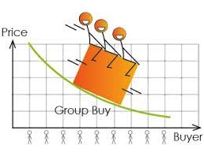
聚眾人之力量
Gathering people's power.

Slide 11


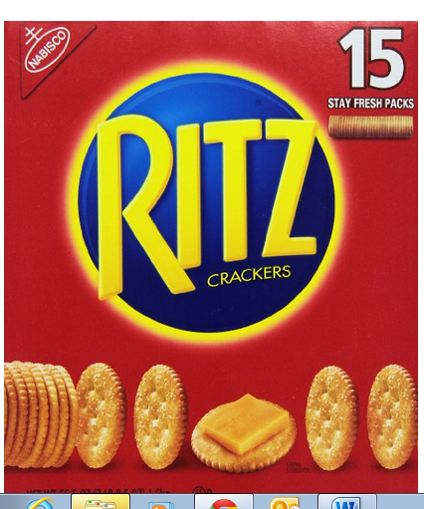
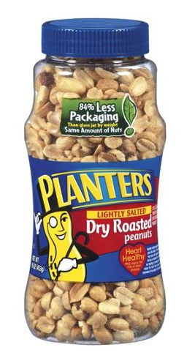
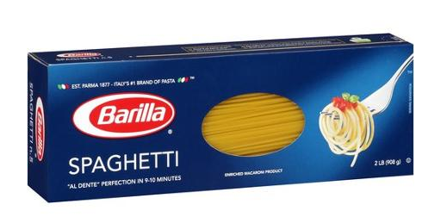
Nabisco Ritz Snack Cracker, 3.5 Pound
Cashback Value
IBV
Price
$7.49
$0.15
.30
Price $15.40
Planters Lightly Salted Dry Roasted Peanuts, 16 Oz
Cashback Value
IBV
Price
$3.50
Price $3.50
$0.00
0.10
Barilla Spaghetti, 2lb
Cashback Value
IBV
Price
$2.42
Price $2.42
$0.00
0.08

Slide 12
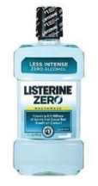
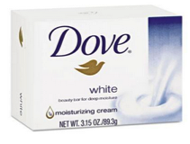
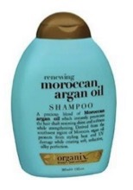
LISTERINE Zero Antiseptic Mouthwash, Clean Mint, 33.8 fl oz
Cashback Value
IBV
Price
$7.99
Price $9.49
$0.32
0.32
Dove®- Moisturizing Bar Soap, Pleasant Scent, 3.15oz, 48/Carton
Cashback Value
IBV
Price
$89.49
Price $95.92
$4.47
17.9
OGX Renewing Moroccan Argan Oil Shampoo, 13 oz
Cashback Value
IBV
Price
$5.74
Price $7.89
$0.32
0.6

Slide 13
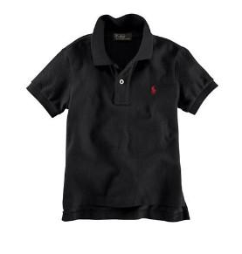
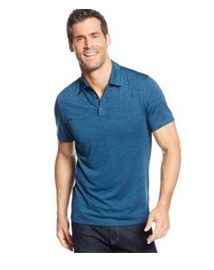
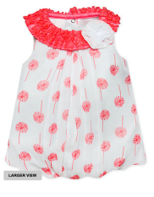
Classic Mesh Polo
Cashback Value
IBV
Price
$35.00
Price $59.99
$0.60
1.20
Alfani Red Performance Polo
Cashback Value
IBV
Price
$24.99
Price $28.00
$0.50
1.00
Baby Essentials Baby Girl’s Bubble Romper
Cashback Value
IBV
Price
$8.24
Price $22.00
0.16
0.32

Slide 14
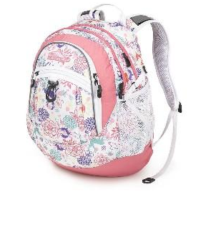
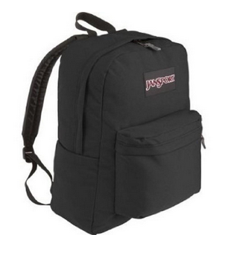
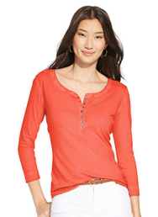
High Sierra Fat Boy Wonderland Pink/Lemonade/White Backpack
Cashback Value
IBV
Price
$29.95
Price $56.04
$0.60
1.20
Jansport SuperBreak Backpack - Black
Cashback Value
IBV
Price
$25.95
Price $29.64
$1.30
0.00
Lauren Jeans Co. Three-Quarter Sleeve Henley Top
Cashback Value
IBV
Price
$17.99
Price $59.50
$0.36
0.72

Slide 15
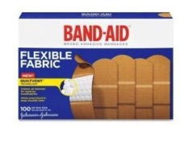
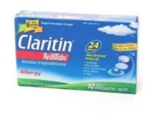

BAND-AID® - Flexible Fabric Adhesive Bandages
Cashback Value
IBV
Price
$5.49
Price $6.43
$0.27
1.10
Claritin 24 Hour Allergy, RediTabs, 10 ea
Cashback Value
IBV
Price
$6.00
Price $12.95
$0.12
0.24
Johnson & Johnson® Red Cross® -
Portable Travel First Aid Kit, 70-Pieces, Plastic Case
Cashback Value
IBV
Price
$5.99
Price $8.54
$0.30
1.20

Slide 16
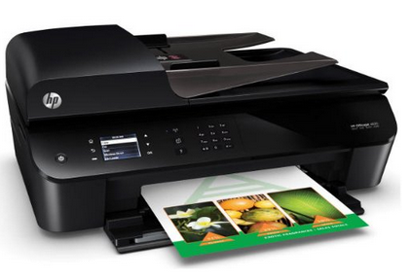
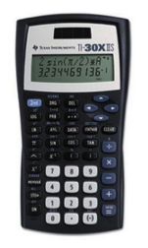
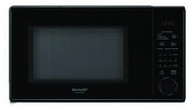
HP Officejet 4630 e-All-in-One Inkjet Printer
Cashback Value
IBV
Price
$69.99
Price $77.00
$0.00
8.49
Cashback Value
IBV
Price
$14.99
Price $17.99
$0.75
3.0
Sharp - 1.1 Cu. Ft. Mid-Size Microwave - Black
Cashback Value
IBV
Price
$79.99
Price $90.23
$0.00
1.04

Slide 17
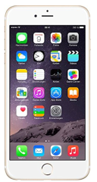
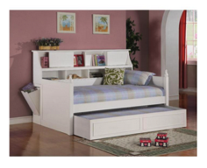
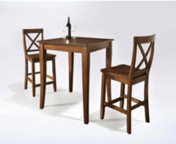
Apple iPhone 6 Plus 16GB Factory Unlocked GSM 4G LTE
Cashback Value
IBV
Price
$849.99
Price $1,273.02
$0.00
8.49
Daisy Bookcase Daybed
Cashback Value
IBV
Price
$778.99
Price $882.44
$46.74
38.95
Crosley 3 PC Pub Dining Set w/ Cabriole Leg &
Stools Cherry KD320001CH
Cashback Value
IBV
Price
$329.00
Price $329.00
$16.45
16.45

Slide 18

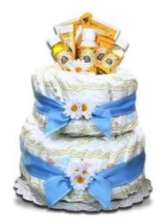
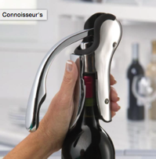
3dRose – InspirationzStore Typography Best Husband Ever
Cashback Value
IBV
Price
$18.99
Price $19.95
$0.38
0.76
Burt's Bees Diaper Cake- Baby Boy
Cashback Value
IBV
Price
$39.99
Price $42.99
$1.10
2.20
Brookstone Compact Wine Opener
Cashback Value
IBV
Price
$39.99
Price $42.99
$2.40
2.00

Slide 19
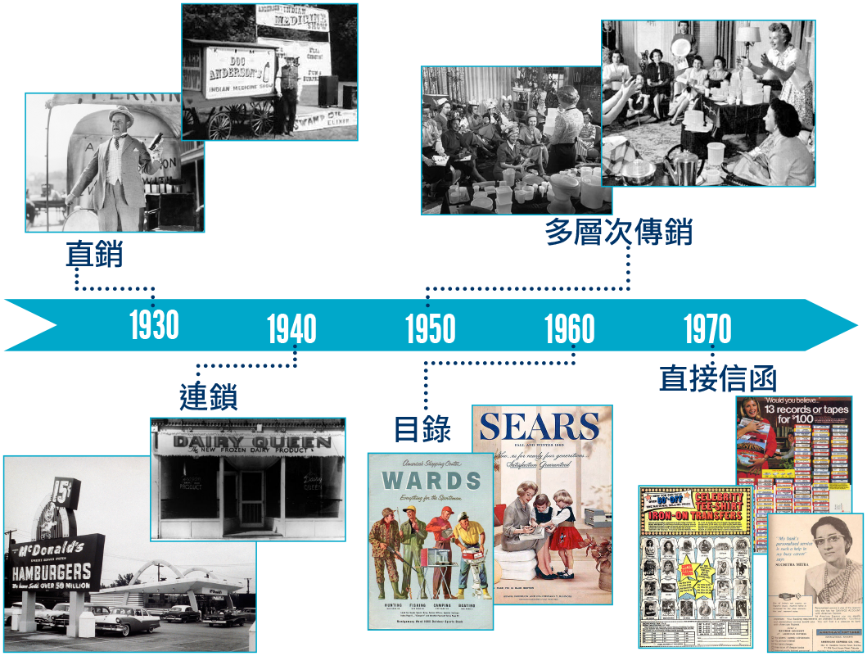
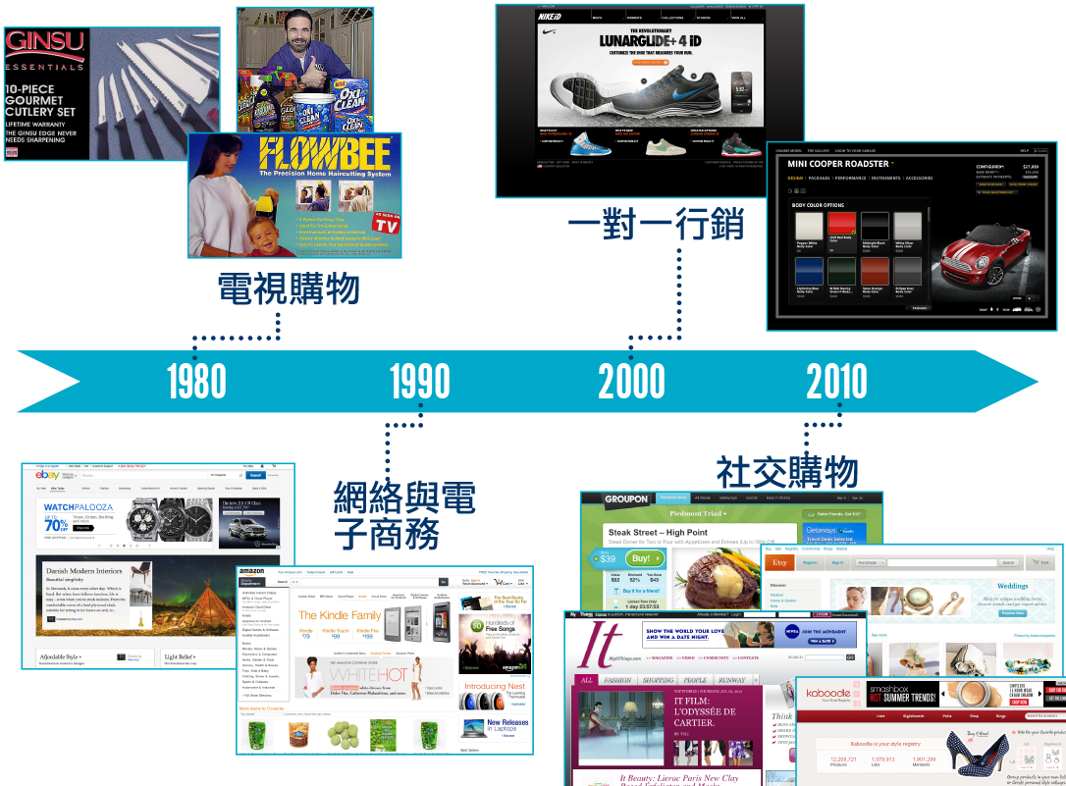

Slide 20







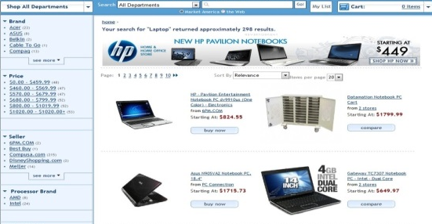
消費轉收入的革命
The revolution of Convert spending into earning
全球數百萬優惠顧客
Millions of worldwide Preferred Customers
現金回贈 Cashback
過千家夥伴商店
Over 1000 Partner Stores
終極購物網站
Ultimate Shopping Website
超級購物車 Super Shopping Cart
20萬超連鎖店主BV/IBV 點數回贈
0.2 million UFOs
BV/IBV reward

Slide 21



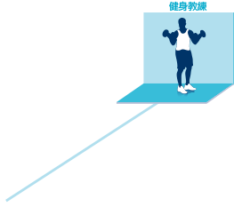



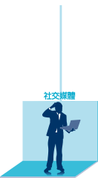




改變10-15名親朋好友的消費習慣
Change 10-15 family and friends' shopping habit

Slide 22



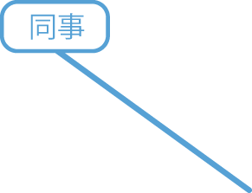


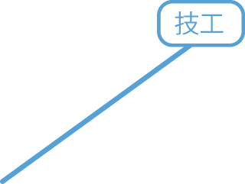
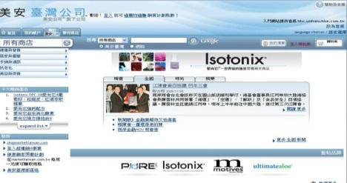


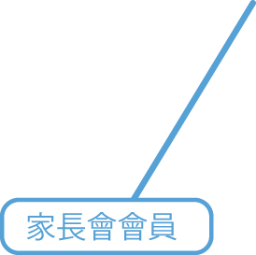





超連鎖™事業 UnFranchise™ Business
Notes:
網路購物 ┼ 加盟連鎖
非常有威力，但是卻又非常簡單。
目前全世界只有美安事做得到。

Slide 23









超連鎖™系統 – 結合人群消費
UnFranchise™ System – Combine the collective consuming power
Notes:
網路購物 ┼ 加盟連鎖
非常有威力，但是卻又非常簡單。
目前全世界只有美安事做得到。

Slide 24
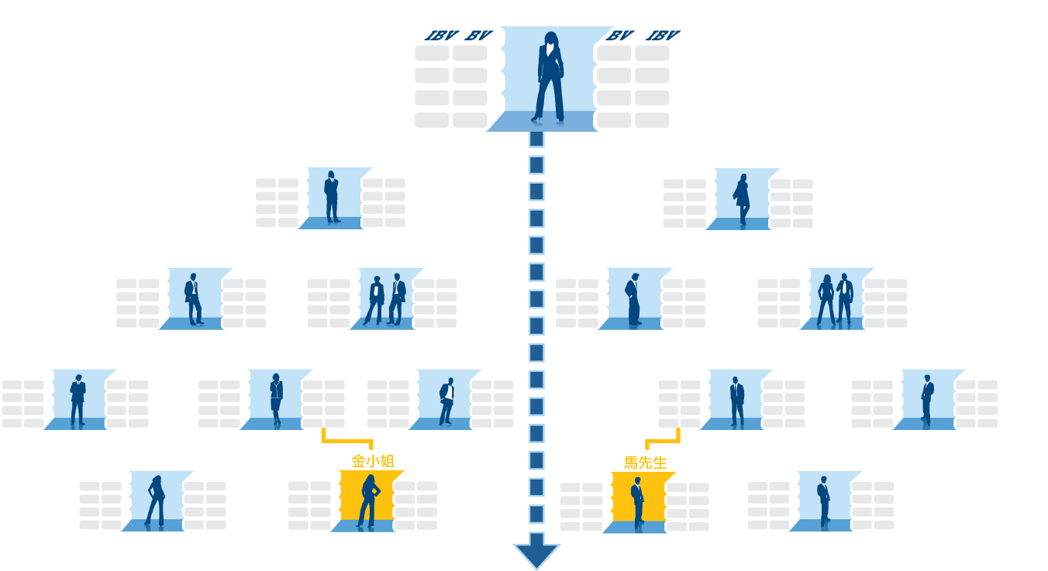


當你擴展組織時，日常消費的利益隨之產生。
When you expand the organization, the daily consumption of interests arise.
業績點數與獎勵業績點數以指數方式成長……
BV & IBV grow exponentially
• 零售 Retail
• 壯大經銷組織 Expand organization
• 優惠顧客透過你的
入門網站訂購 PC order products via your portal
• 購買産品自用 Purchase products for personal use
• 擴展客源 Expand customer sources
- 口碑宣傳 word of mouth
- 網路 Network
- 散播式行銷
Distributed marketing
- 數位行銷 Digital Marketing
Notes:
24
談論要點
不斷代不打折，真正的無限代累積。
而且只要發展兩個組織網。
無限代累積，再加上雙軌制的特別效應：多人、多點數。真正能幫助新人順利起步。
多人：組織發展到一定程度，當有人要入會時我們沒有第三條線，只能放到最下面。這樣對中間的人來說，就多了一個伙伴。這在過去太陽線的組織來說是不可能發生的。而在美安，因為雙軌制再加上無限代累積，我們在幫助別人時自己沒有任何的損失，所以大家都樂於幫助伙伴。
多點數：美安是目前唯一可以把點數往下放的公司。我們可以把自己訂貨產生的點數，送給我們親自推薦的伙伴，由他開始以上所有的人都可以累積到這筆點數。讓點數發揮最大的效益。抄襲美安雙軌制的公司無法做到點數往下放，因為沒有網路電腦管理系統的支援。

Slide 25
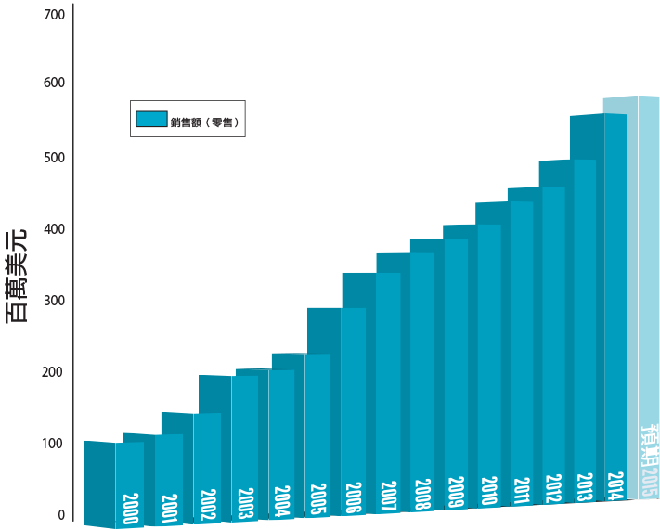
預估總零售額†:Estimated accumulated retail sales†:
US$6,427,846,637*
*至2014年6月30日止（自公司成立以来）
*至2015年6月30日止（自公司成立以来）
*As of June 30, 2015 (since the company’s inception)
†預估總零售額係依建議零售價計算
†Estimated accumulated retail sales based on suggested retail price

Slide 26
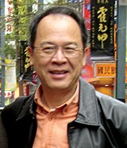


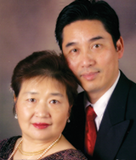
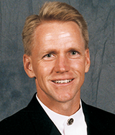













































































美安集團|SHOP.COM™正在改變人們購物的方式和經濟的型態。
每個人都可以透過打造自己的經濟達到財務獨立。
Market America™ | HK.SHOP.COM™ is changing the way that people shop and changing the economic paradigm so everyone can become financially independent by creating their own economy.
已賺取的總佣金收入 Total commissions earned:
$1,656,393,718
+
=
超連鎖店主賺取的總收入 :Total UnFranchise® Owner earnings:
$3,353,605,372*
預估總零售利潤 †:
Total estimated retail profits earned†:
$1,697,211,654
*至2015年3月31日止。 †預估總零售利潤系依建議零售價計算

Slide 27




過去 10%的轉移
10% Conversion in the past
50 x 50 BV = 2,500 BV
50 x 50 BV = 2,500 BV
50 x 10 IBV = 500 IBV
50 x 10 IBV = 500 IBV
Notes:
TRAINERS NOTES:
This is an organization of 50 people on the left and 50 people on the right
Everyone is doing the minimum activity requirements / not participating in the Shopping Annuity
The multiplier is small because no one is really doing the business and definitely not doing the shopping annuity , therefore only creating $600 per month in BV checks and $300 every 3 months in IBV commissions.

Slide 28


現在100%的轉移
100% Conversion
50 x 500 BV = 25,000 BV
50 x 500 BV = 25,000 BV
50 x 100 IBV = 5,000 IBV
50 x 100 IBV = 5,000 IBV
Notes:
TRAINERS NOTES:
This is an organization of 50 people on the left and 50 people on the right
Everyone is doing the minimum activity requirements / not participating in the Shopping Annuity
The multiplier is small because no one is really doing the business and definitely not doing the shopping annuity , therefore only creating $600 per month in BV checks and $300 every 3 months in IBV commissions.

Slide 29


美安香港「購物年金的效應」
The “Shopping Annuity Effect” of Market Hong Kong

Slide 30
購物年金「4 個基本步驟」
The 4 steps of Shopping Annuity
將家中日常生活用品，從其他品牌落實轉換成美安公司獨家代理的品牌
每月或定期購買的非獨家代理產品(如衣服、電子用品、電器等)，從其他店面改變至 SHOP.COM伙伴商店購買。
與10-15 個人建立信任好關係，鼓勵 跟你做一樣的事。
幫助 2 個以上的人，重複執行以上步驟。
Change the brands of products they are currently buying for their households each and every month to mhkBranded products.
Change how they buy all other brands of products they buy monthly or periodically (such as clothes, electronics, appliances, etc.) from “brick and mortar” establishments to “click and order” through their own HK.SHOP.COM website from those same establishments.
Encourge 10-15 individuals to do the exact same thing and build relationships
Identifying 2 or more individuals committed to improving their financial situation by performing the steps above!

Slide 31

投資者的心態
Attitude of Investor
真心誠意的關懷
Care
簡單複製
Duplication

Slide 32
總結 Conclusion
這是一場我們都可以參與的消費轉賺錢----革命
我們採取的行動----購物年金4件事
我們傳達消費在一起的信念
我們2-3年的成果----永續收入
This is a “Convert Spending into Earning” movement that we can participate in ---- revolution
Take action ---- The 4 steps of Shopping Annuity
We are spreading the faith of gather spending
Our 2--3 year plan ---- residual earning

Slide 33


五年內IBV收入 = BV收入，一家店做滿，年收入達到50萬美金！
In 5 years, commissions from IBV will equal to that from BV. Complete one BDC with annual income of US$500,000!
到2020年 整個會場坐滿高級顧問經理級 (Director)！(至少20000人)
In 2020, this coliseum will be filled with Directors (at least 20,000 people!)

Slide 34


Slide 35


Slide 36
45年計劃
45 YEAR PLAN
2到3年計劃
2 TO 3 YEAR PLAN

Slide 37





Slide 38

2015 美安香港成功領袖會議
MHK Leadership Conference 2015

